Slide 1
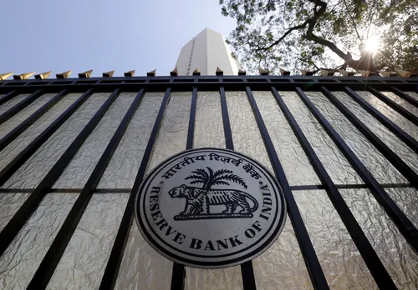
Analysis of Commercial banks of India
GROUP 15
-Souhardya Mitra
-Hemant Nikhade
-Vinay Verma
-Adithya.L
INSTRUCTOR
DR.DOOTIKA VATS

Slide 2

COMMERCIAL BANKS
PUBLIC
SECTOR
BANKS
e.g. SBI, Indian bank, Uco bank
PRIVATE
SECTOR
BANKS
e.g. Axis bank, ICICI bank, HDFC bank
REGIONAL RURAL
BANKS
e.g. Nagaland Rural Bank, Odisa Gramya Bank

Slide 3

Data collection
ASSETS AND REVENUES OF VARIOUS COMMERCIAL BANKS
BRANCHES ACROSS INDIA
GOVERNMENT SHARE HOLDING IN PUBLIC SECTOR BANKS
LOCATION OF HEADQUARTERS IN INDIA

Slide 4

PUBLIC SECTOR BANKS
Association between assets and revenue of the bank
Government share in the banks
Reason behind the geographical location of headquarters

Slide 5
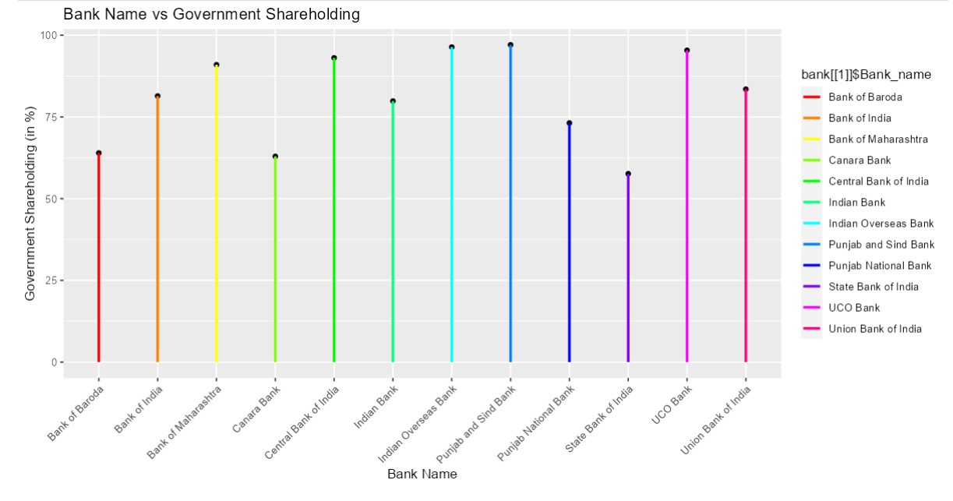

Slide 6
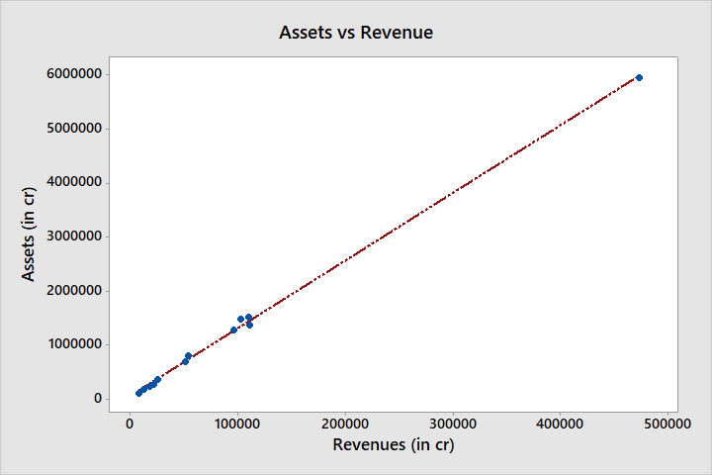
Assets vs Revenues of Public Sector Banks
Assets = 58503 + 12.53 Revenues
R- Sq =99.8%

Slide 7

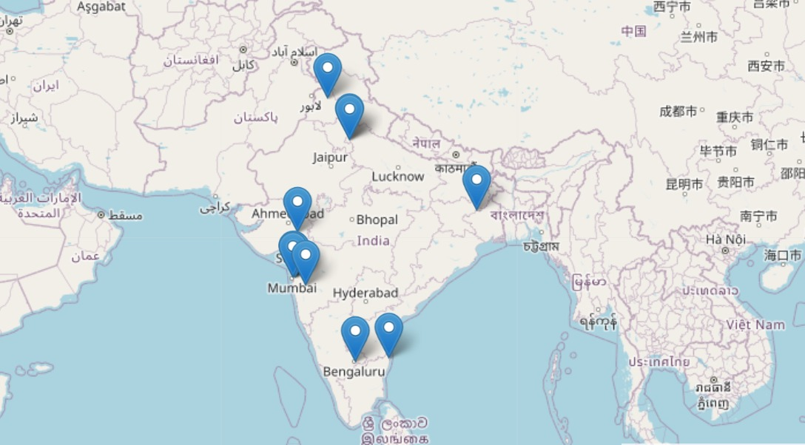
Location of Headquarters of Public Sector Banks in India

Slide 8
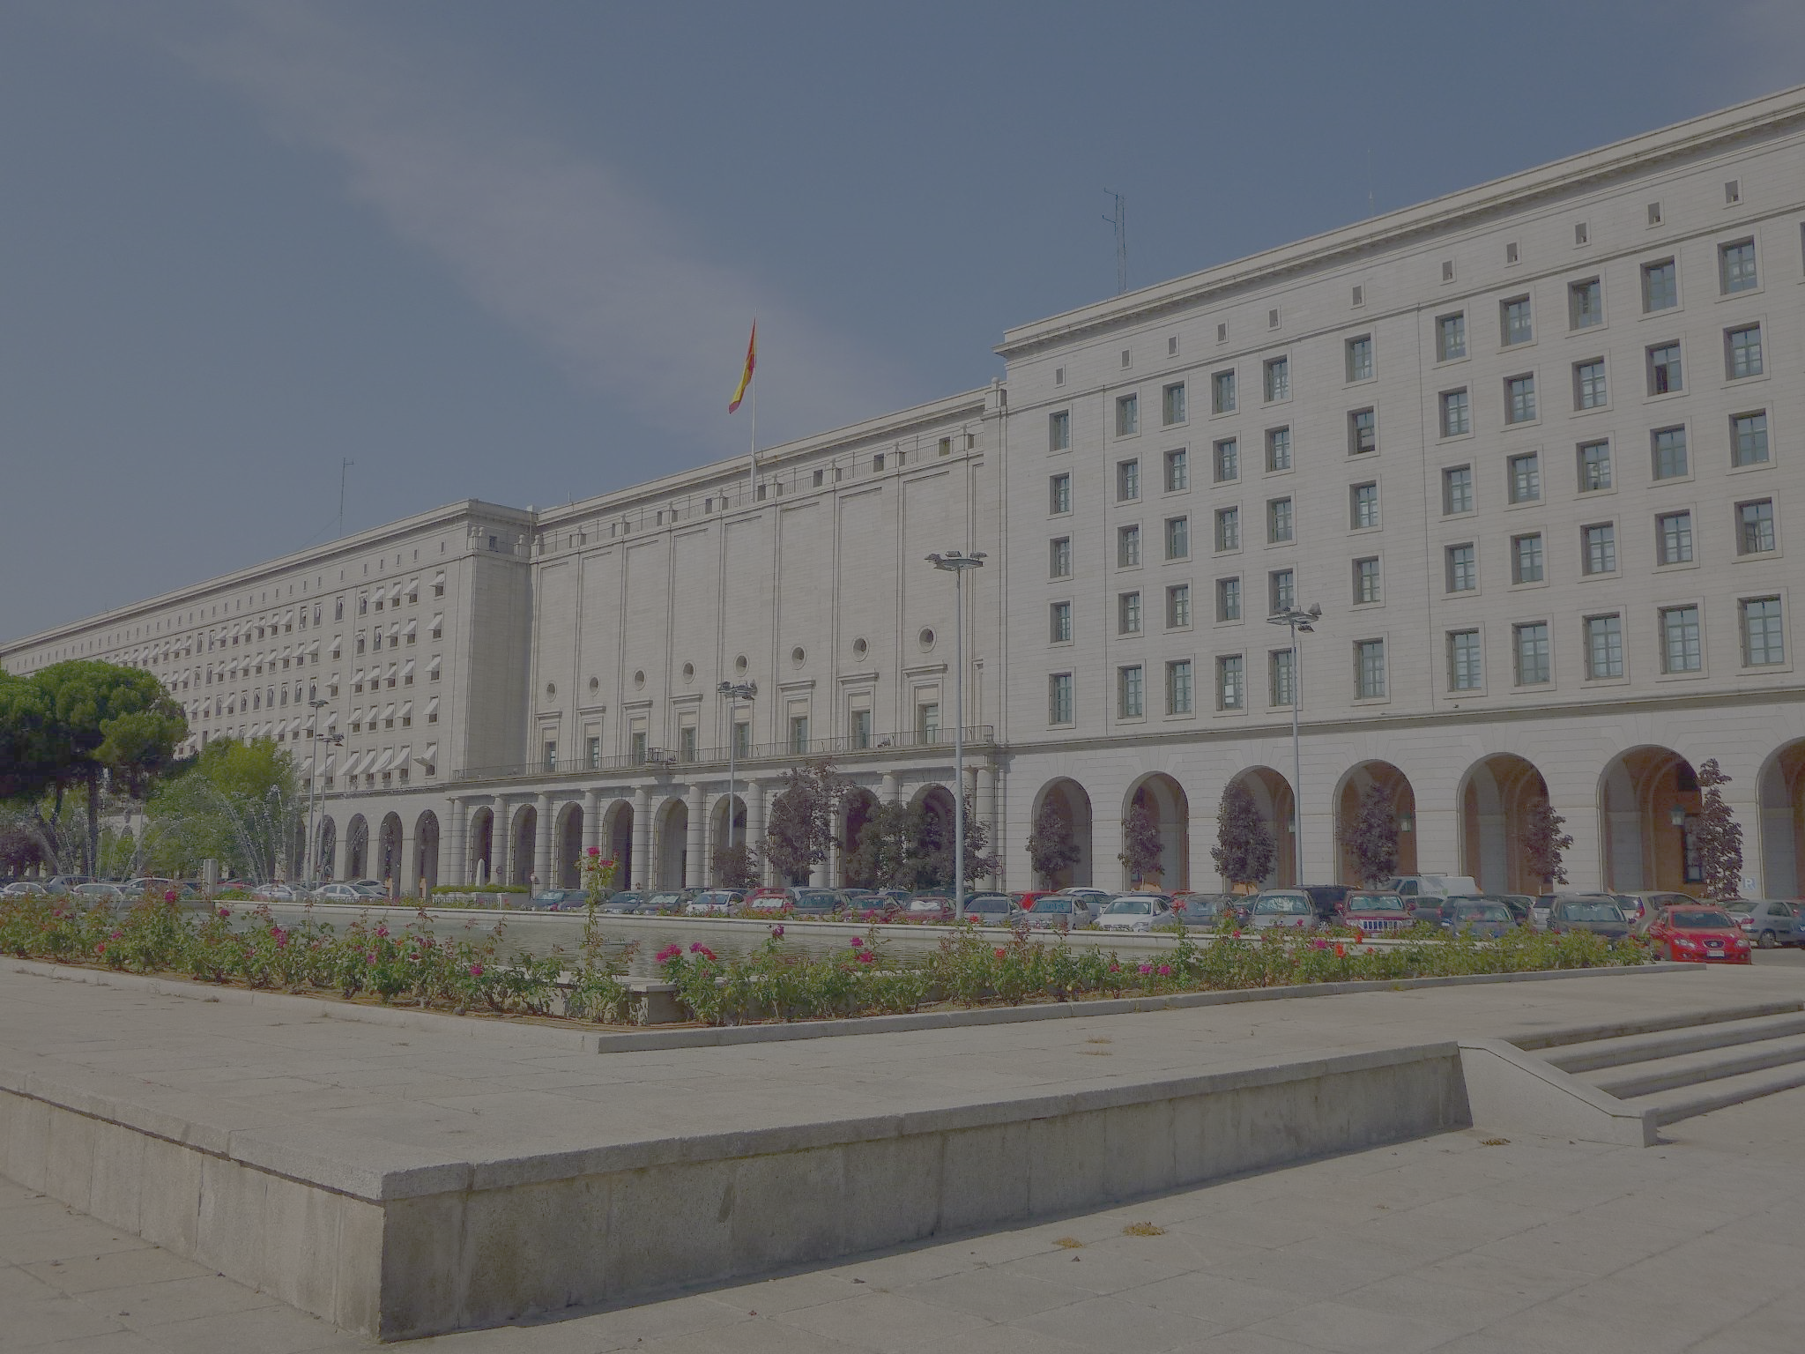
PRIVATE SECTOR BANKS
Private Sector Banks
Why the private sector banks are deprived of assets and revenues as of public sector banks ??
Why the private sector banks are deprived of assets and revenues as of public sector banks ?
Geographical location of headquarters
Number of branches of various private sector banks across India

Slide 9
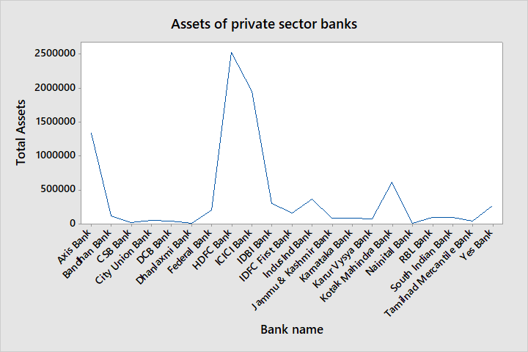
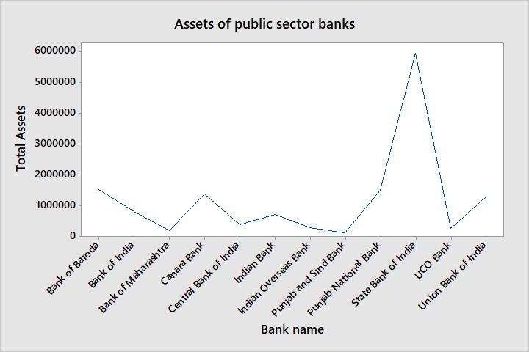
Add a Slide Title - 1

Slide 10
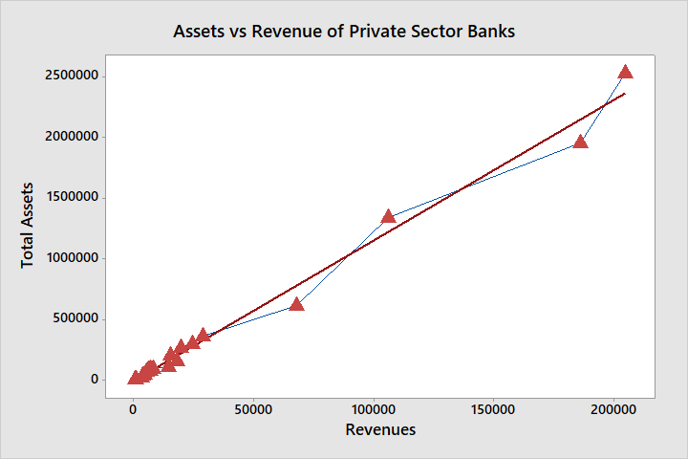
Add a Slide Title - 3
Assets = -3995 + 11.58 Revenues
R-Sq = 98.8%

Slide 11
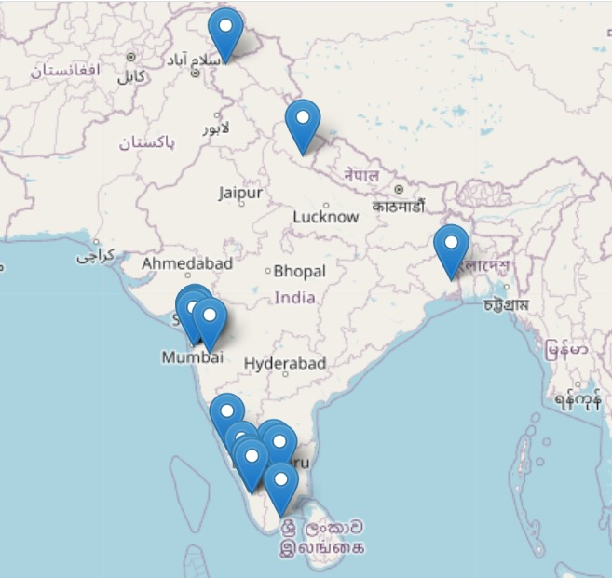
Location of Private Sector Banks

Slide 12
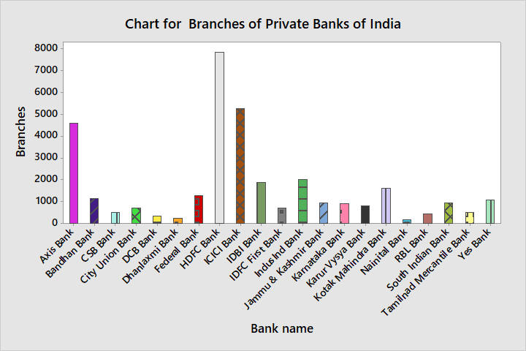

Slide 13

Regional Rural Banks
Regional Rural Banks
Reason behind spreading all over the India
(almost every state)
Branch distribution of RRB
Share of assets in RRB

Slide 14
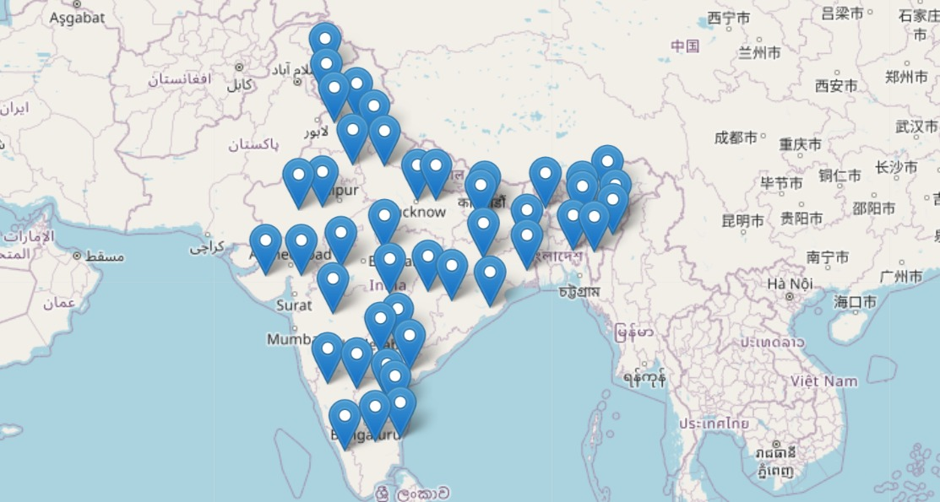
Location of HQ of Regional Rural Banks

Slide 15
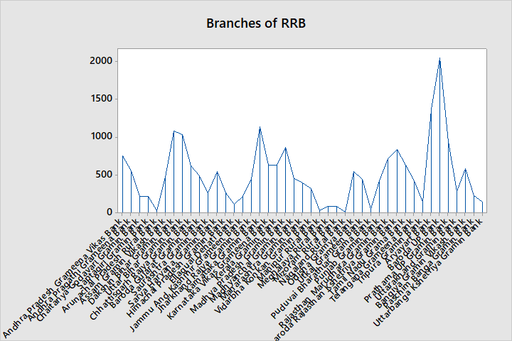

Slide 16
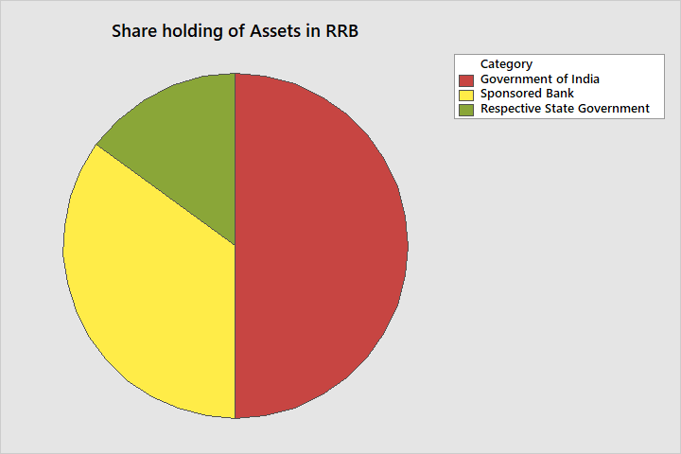

Slide 17

SHINY APP (GROUP -15)

Slide 18
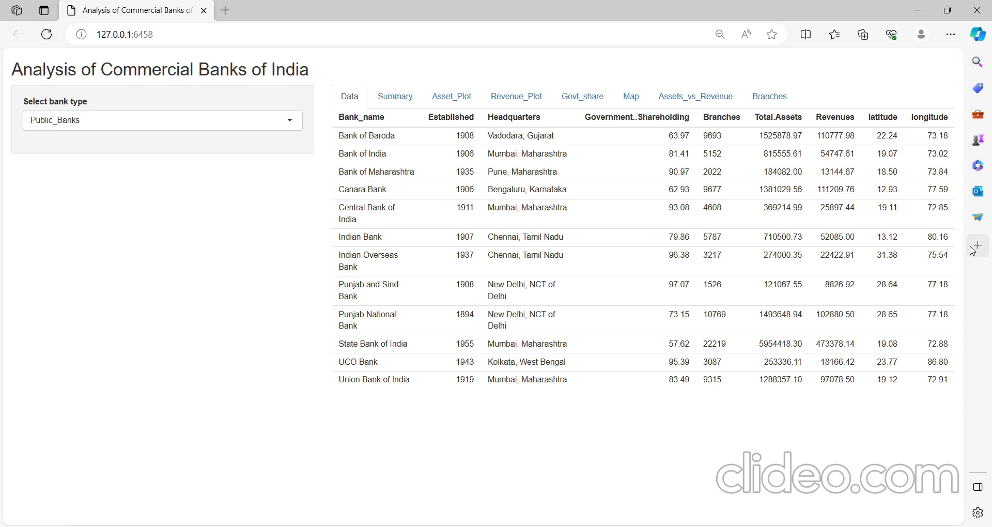

Slide 19
ACKNOWLEDGEMENT
We would like to express our gratitude to Dr. Dootika Vats for her contribution to the completion of the project

Slide 20

THANK YOU!
GROUP -15

